Slide 1
Community/Youth Programs
Community Programs
CYLA

Slide 2
Faith in Action Programs
Featured Programs
Global Wheelchair Mission
Habitat for Humanity
Coats for Kids
Non Featured Programs
Helping Hands
Catholic Citizen Essay Contest
Free Throw Championship
Soccer Challenge
Disaster Preparedness (Bill McCrossen, Chairman)
Notes:
Supreme Sponsored Programs
However Your Council May Have Your Own Community Programs

Slide 3
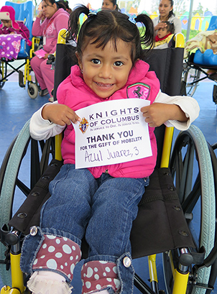
Global Wheel Mission
Mission
Help change the lives of people with disabilities
Feature Program Requirements
Donate at equivalent to 10 wheelchairs. ($1,500)
American Wheelchair Mission

Slide 4
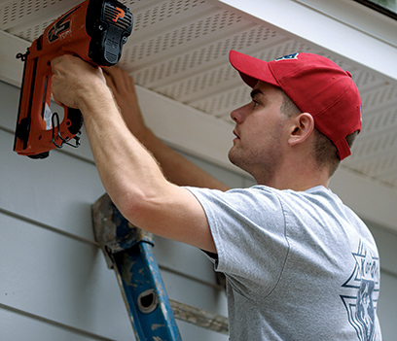
Habitat For Humanity
Mission
Partner With local Habitat For Humanity Organization
Build Homes for the Needy.
Feature Program Requirements
Donate at least $1,000
Donate 200 service hours towards building a home

Slide 5
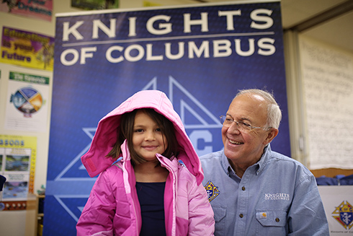
Coats for Kids
Mission
  Ensure no children (especially needy children) are left without coats during the winter.
  Feature Program Requirement
  Purchase and distribute 6 cases of coats (approx. Cost $1,400).
  Different Packages to Order from Supreme

Slide 6
Coats for Kids
12 Coats Per Case in Some
Almost $20 a Coat
$237.38 A Case
24 Coats In Two Options
Almost $14 A Coat
$334.80 A Case

Slide 7
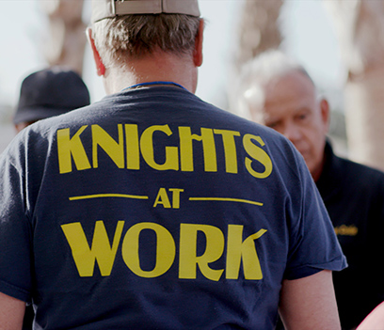
Helping Hands
Mission
To Help Less fortunate in your Community - Poor, Elderly, Homeless, Needy, etc.
Very Broad Program
Notes:
Just about anything Your Council do for the needy, elderly, homeless or less Fortunate would fit in this program

Slide 8
Catholic Citizenship Essay Contest
Topic
Explain how young Catholics can evangelize our faith to families and friends who have turned away from religion and encourage them to return to the Church and embrace the sacraments?
Open to all Catholic Students Grades 8-12
500-750 words
Essay Must Be Typed
Entry Forms With Essay

Slide 9
Catholic Citizenship Essay Contest
A Winner In Each Grade Level
Important Deadlines
November 5, 2022- Turn in to Council
December 5, 2022- Turn In to Diocesan Administrators.
Order Kits Now

Slide 10
Soccer Challenge
  Youth Kicking Penalty Kicks
  Open to Boys & Girls 9-14 Years old
  Separate competition in age and gender group
  Council Deadline - September 30
  Order Kits Now
  Age Determined Sept 1st.

Slide 11
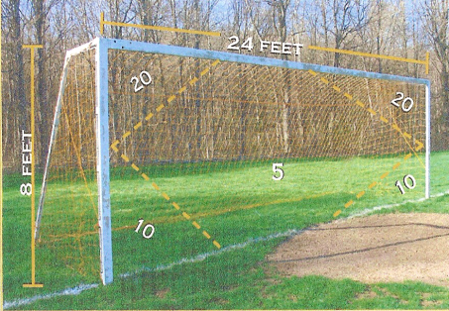
Regulation Goals Are Ideal
Use Smaller if Necessary

Slide 12
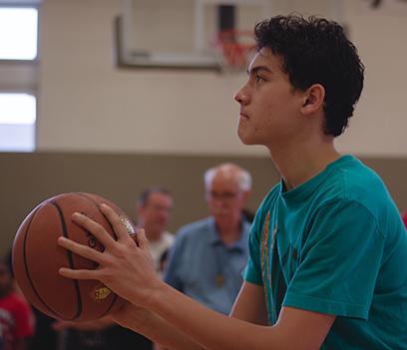
Free Throw Contest
Open to Boys & Girls 9-14 years old.
Separate competition for age and gender
Age is Determined - Jan 1st
Council Contest – December - January
Council Deadline - Jan 31, 2023
International Winner Last Year
Notes:
Caroline Watson-13 year Girl declared an international winner

Slide 13
CYLA PROGRAM
Catholic Youth Leadership Award (CYLA)
Cash scholarships offered to Catholic 12th graders in public, parochial, or private school.
Each council can select 1 Boy and 1 Girl winner.
Send your winning application to your Diocesan Administrator.
1st Place: $4,000
2nd Place: $2,000
3rd Place: $1,000
Diocesan: $1,000

Slide 14
CYLA PROGRAM
Catholic Youth Leadership Award (CYLA)
Application Changed
Instructional Video
Council CYLA Certificate
Notes:
Encourage all Councils to encourage all students to utilize the current CYLA form that will posted on the state Website
In the process of trying to construct a Instructional Video that will help the students to fill out a stronger application
We hope soon to have certificate that Council use to recognize their Council winners that will be on the state website.

Slide 15
Catholic Youth Leadership Award (CYLA)
January 25: Deadline to turn applications to Council
February 7: Councils submit winning applications to Diocesan Administrators.
April 1: State Finals in Plaquemine.
Confidential Grading Guide: Contact Delmas Forbes.
Notes:
Grading guide will be emailed to all Councils and Diocesan Administrations around October or November

Slide 16
Important Reminders
Utilize Catholic Schools for Youth Contests

