Slide 1
Faith in Action

Slide 2

Cross Catholic Outreach (CCO)- LA KofC

Slide 3
Louisiana KofC Leadership:
Tremendous synergy between our own Faith in Action goals, and the goals of CCO, in fulfilling Christ’s ministry to the poorest of the poor, at home and abroad.
A chance to exercise our core values of Charity, Fraternity, and Unity in a state-wide effort, involving all our Councils, focused upon a single goal- in this case, a Food Packing Event.
Thereby to demonstrate the effectiveness of full, state-wide mobilization in producing a work of Charity well in excess of any single Council, District, or Diocese.

Slide 4
Louisiana KofC Leadership:
By its exercise, involving whole families, to further enhance the role of Catholic men, especially men of our Order, as Domestic Church leaders
By its side-effects, to further our branding, recruitment, and Faith in Action initiatives

Slide 5
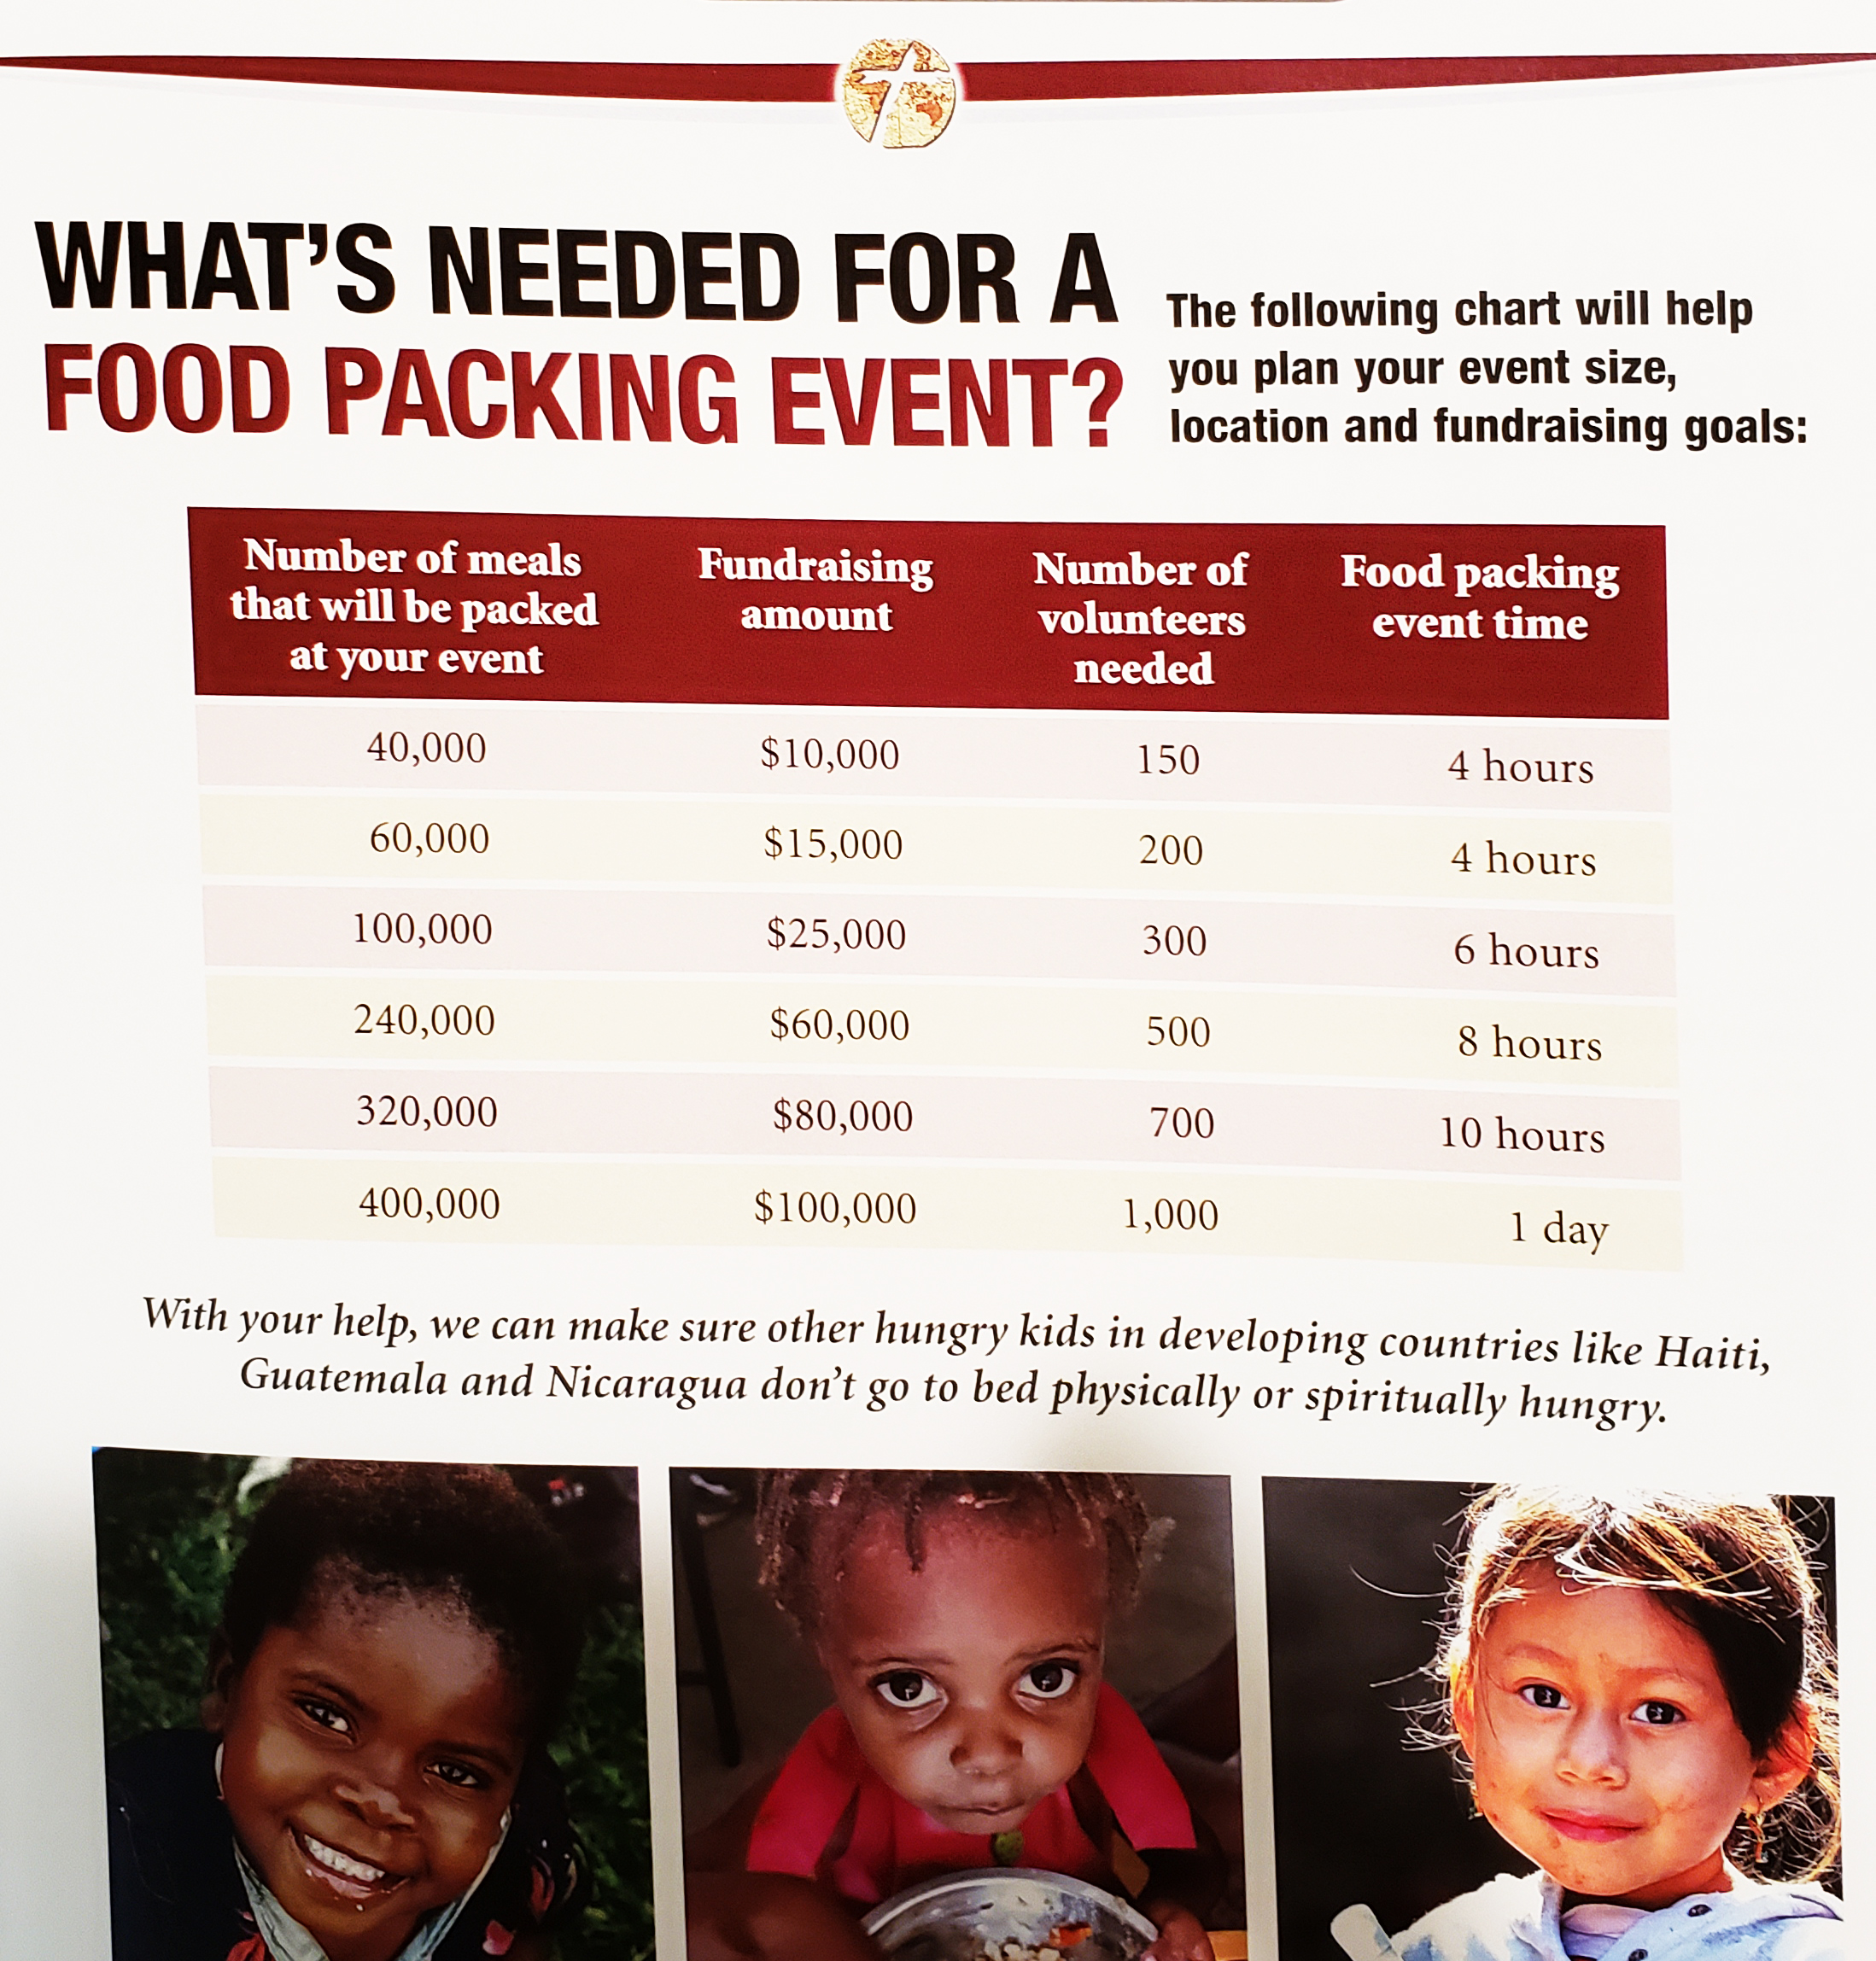
CCO and LA KofC Food Packing Events

Slide 6
CCO and LA KofC Food Packing Events
Coordinated State-wide exercise in Charity, Unity, and Fraternity over the course of a year, with “first fruits” 40K meal event around May-June timeframe. More events over ensuing months.
Every Council- donate $250, 2-3x more via personal donations, to State 501-3(c). Results: 12oK meals, 12K La, remainder OS, within a year.
Every Council- elicit possible parish staging areas with pastors.
Every Council- identify possible sources for youth (appropriated protected), young adult, and family participation.

Slide 7
Cross Catholic Outreach and LA KofC Food Packing Events
State Coordinator: Michael J Torma, tormathree@gmail.com, 318 773-0815
State Co-Coordinator: TBD
Cross Catholic Outreach Coordinator: June Lawrence, jlawrence@crosscatholic.org, 561-392-9212 ext. 118

Slide 8
Why Us, and Why Now?
Another Carl Anderson quote----

Slide 9
Why Us, and Why Now?
Another Carl Anderson quote----
We are at a moment in history we cannot avoid, and a crossroads we cannot escape.
Ours is a brotherhood we must prosper, in order to sanctify the world.
***

