Slide 1
Knights of Columbus Family Programs

Slide 2
CONSECRATION TO THE HOLY FAMILY
#10605 Guide Sheet
#10666 Preparation Steps
#10371 Prayer Card
#10665 Brochure
#10663 Vertical Poster
Overview:
To help families live out the joy of Christ, Supreme Chaplain Archbishop William Lori has composed a prayer through which families will come together to consecrate themselves under the protection of the Holy Family. In this prayer, we ask for the aid or intercession of the perfect son Jesus Christ, Mary the perfect mother, and Joseph who is a model for every father. Councils will guide their parishes and community to understand and offer this important and impactful prayer. Preparing for the Consecration to the Holy Family is not a single event. It is choosing a way of life for your family. Through this consecration, each participant is consciously choosing to be a beacon of God’s love through His Church. For Consecration to the Holy Family resources, visit www.kofc.org/consecration.
Overview:
During his visit to the Philippines, Pope Francis cited the need for “holy and loving families to protect the beauty and truth of the family in God’s plan and to be an example for other families”. The Family Fully Alive monthly devotions are concrete ways that Knights of Columbus, in solidarity with Pope Francis, can support the growth of holy and loving families in the Church. The Family Fully Alive Program asks families to invite God into their homes and cultivates each family as a miniature domestic church. To this end, the program provides monthly themes, scripture verses and activities. Through prayer and reflection, each family has the opportunity to grow in holiness together. This is a flexible program that can be started at any time of the year and continues year-round. For Family Fully Alive resources, visit www.kofc.org/familyfullyalive. Featured Program Requirements • For two program credits toward the Columbian Award – Distribute and actively promote the use of the Family Fully Alive Booklets (#10162).
Overview:
Despite Good Friday’s central role in the heart of Christianity, attendance at services remains low. In an effort to change this, councils will encourage participation in Good Friday services through a promotional campaign. Setting an example for their community, Knights will attend Good Friday services with their families and work with their pastors to encourage increased parishioner involvement at these liturgies. In conjunction with these efforts, councils will also work to educate their parishes about the plight of Christians in the Holy Land. For Good Friday Family Promotion resources, visit www.kofc.org/goodfriday.
FAMILY FULLY ALIVE
#10606 Guide Sheet
#10664 Vertical Poster
#10162 Booklet
GOOD FRIDAY FAMILY
PROMOTION
#10611 Guide Sheet
#10573 Horizontal Poster
#10638 Vertical Poster
#10639 News Release - Fillable

Slide 3
FAMILY PRAYER NIGHT
#10608 Guide Sheet
#10691 Vertical Poster
#10692 Brochure
#10693 News Release - Fillable
• Additional Program Material Available
Overview:
Catholics often struggle with the reality that they do not have the opportunity to socialize and/or pray with other faith-filled Catholic families. It can be quite a challenge to raise our children in the faith when their only exposure comes from Mom and Dad. Put plainly, the majority of our time can easily be spent in secular circles unless we intentionally create ways to live out the domestic church. Family Prayer Night is an opportunity for children to be exposed to regular people living their faith in a casual setting. Families of council members, as well as other Catholic families within the parish and community, will gather for prayer, dinner and fellowship. Multiple groups can be formed and families are encouraged to rotate between these groups. For Family Prayer Night resources, visit www.kofc.org/prayernight. Featured Program Requirements • For two program credits toward the Columbian Award – Organize a minimum of four Family Prayer Nights, one for each quarter of the year.
Overview:
Knights of Columbus councils will dedicate a special week of the year to recognize the vital importance of families as the foundation of our domestic church and to promote Catholic family values. When choosing a week, councils should consider factors that might affect parishioner schedules such as school vacations, holidays and other local events. Though traditionally celebrated in the summer to commemorate the birth and death of our founder, Blessed Michael McGivney, this program can take place anytime during the year. For Family Week Resources, visit www.kofc.org/familyweek.
Overview:
Knights of Columbus are committed to helping end hunger through the Food for Families Program which has donated millions of dollars and millions of pounds of food toward this end. Council and parish families will raise funds to support their local food pantries, food banks and soup kitchens. For every $500 or 1,000 pounds of food donated, the Supreme Council will refund $100 back to the council – up to a maximum of $500 per council per fraternal year. Though in-kind donation of food is valuable, leaders of hunger-relief organizations often comment that financial contributions can be stretched even further and allow nonprofits to procure the exact items needed by the organization and its clients. For Food for Families resources, visit www.kofc.org/food. Featured Program Requirements • For two program credits toward the Columbian Award – Collect a minimum of $500 or 1,000 pounds of food for a parish or community food pantry and contribute a minimum of 100 total man-hours in preparation/distribution/service of meals. Report activity and apply for the refund using the Food for Families Refund Application (#10057). Please Note: Participating in the Food for Families Program does not satisfy the programming requirements for the Helping Hands Program. The two activities are separate and cannot be double-counted.
FAMILY WEEK
#10609 Guide Sheet
#10652B Calendar Poster
#10662 Suggested Activities
#10510 Vertical Poster
#10652A Calendar Flyer
#10656 News Release - Fillable
FOOD FOR FAMILIES
#10610 Guide Sheet
#10057 Food for Families Refund
#10658 News Release - Fillable
#10511 Brochure
#10657 Vertical Poster

Slide 4
Keep Christ In Christmas Program
Poster Contest

Slide 5
Resources www.kofc.org Click on “For members”, “Programs”, “Family Tab”
KEEP CHRIST IN CHRISTMAS
#10604 Guide Sheet
#10681 Program Guide Book
#9898 Journey to the Inn Booklet
#2757 Spread the Light of Christ Poster
#2760 For Unto Us a Child is Born Poster
KEEP CHRIST IN CHRISTMAS POSTER
CONTEST RESOURCES
#5024 Poster Contest Guide Book
#5025 Poster Contest Entry Form
#5026 Poster Contest Vertical Poster (English)
#5026S Poster Contest Vertical Poster (Spanish)
#5028 Poster Contest – Participant Certificate
#5022 Poster Contest – Winner Certificate
#10661 Poster Contest Promotional Letter
#10660 Poster Contest News Release
• Kit contents available on program guide sheets and can be ordered along with additional program material via Officers Online
Overview:
The Knights of Columbus offers multiple activities that promote Christmas and the season of Advent in their proper context: Journey to the Inn, Light Up for Christ, Crèche or Advent Wreath Blessing, and the Christmas Poster Contest. These activities are centered on the example of the Holy Family and the Nativity of Our Lord and Savior, Jesus Christ. The Keep Christ in Christmas (KCIC) Program brings all KCIC activities together under one umbrella. It encourages councils to prompt their neighbors to shift from a preoccupation with materialism to the light of Christ and the spirit of giving. KC activities include whatever efforts best suit the parish and community of a particular council and do not need to originate from the Supreme Council. For Keep Christ in Christmas resources, visit www.kofc.org/christmas.
OVERVIEW:
Conducting a Knights of Columbus Keep Christ in Christmas Poster Contest is a fun and easy way to put your faith into action and get youth in your community involved in their faith. It is fun to conduct because of the opportunity to witness the creativity and optimism of the youth in your community. It is easy because you can tap into existing structures like schools and do a lot of preliminary work. It can also provide excellent local, and potentially international, publicity for your council.

Slide 7
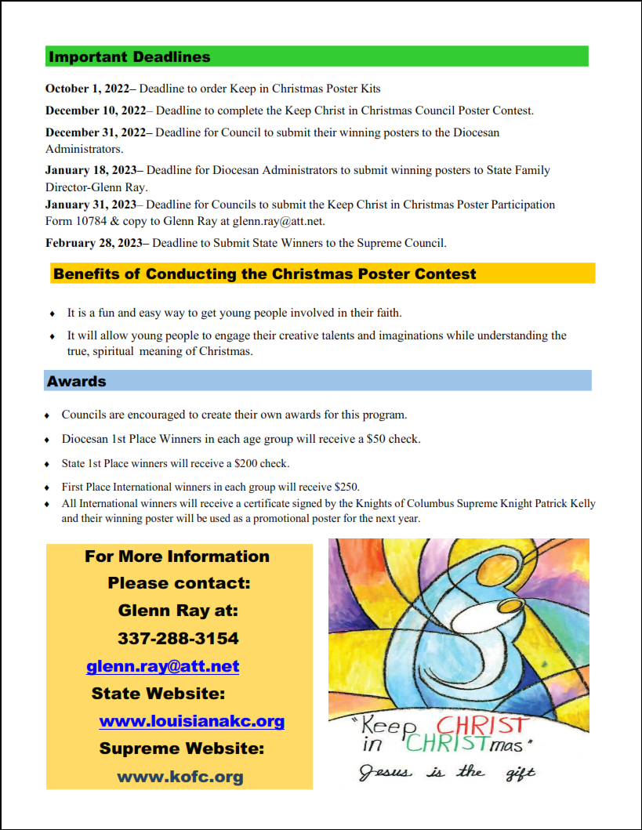

Slide 8
Family of the Month Family of the Year

Slide 9
Information can be found at WWW.KOFC.ORG
under the FAMILY programs tab
FAMILY OF THE MONTH/YEAR
#10607 Guide Sheet
#10680 Family of the Year Entry Form
#10667 Family of the Month News Release
#1993 Guide Book
#1843 Family of the Month Certificate
#1843A Family of the Year Certificate
Family of the month is due by the 15th of the following month. Each Council should participate in this program. Total of 12 per year is recommended. Use Form 10784 on KOFC Supreme website to complete report.
Overview:
Each month, the council Family of the Month committee selects one parish family that models Christian family values and visibly lives them every day. Once a year, each participating council also selects one of the previous twelve Family of the Month winners to represent the council/parish as the potential international Family of the Year. The Knights of Columbus Family of the Year is chosen by the Supreme Council and recognized each year at the annual Supreme Convention. For Family of the Month/Year resources, visit www.kofc.org/familyofthemonth. Featured Program Requirements • For two program credits toward the Columbian Award – Recognize twelve families throughout the fraternal year (one each month) and submit a Family of the Year to the jurisdiction. Report activity using the Fraternal Programs Report Form (#10784) each month and a Family of the Year Entry Form (#10680) by the jurisdiction due date.

