Slide 1
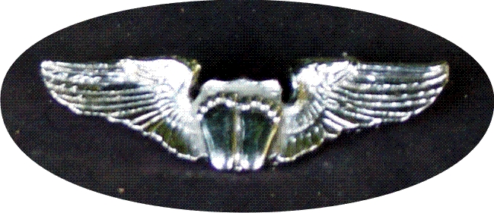
Pro-Life Ace Wings Award
Louisiana Knights of Columbus

Slide 2
ACE Stands for Pro-Life…
without Apology
without Compromise
without Exception
This Photo by Unknown Author is licensed under CC BY-NC-ND

Slide 3
“Precious Feet”
The Ace Wings are 2 inches wide and 5/8 inches high and are metallic.
The “Precious Feet” are the exact same size and shape of an unborn baby’s feet at 10 weeks after conception.
This Photo by Unknown Author is licensed under CC BY

Slide 4
Who can receive the award?
Any Knight of Columbus in the State of Louisiana are eligible if they meet the requirements
A member may request a set of wings for his spouse or children if they participated in the Pro-Life events with him.
A Council may present the ACE Wings Award once a year to a non-Knight in their local community that has demonstrated a strong Pro-Life stance.
Councils may elect their Parish Priest to receive the Ace Award.
An actively Pro-Life Priest does not need the requirements if he is a Priest and actively Pro-Life.

Slide 5
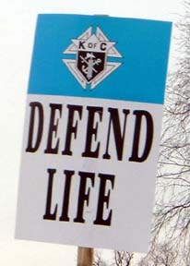
So, what are the requirements?
A minimum of 5 Public Pro-Life events are required to qualify for ACE Wings Award. 4 out of 5 must deal with the unborn.
Examples include:
Pro-Life Masses, Sidewalk Counseling, 40 days for life, Pro-Life Conferences, Volunteer at a Crisis Pregnancy Center, Pro-Life Parades, Motorcycle Ride for Life, Hike for Life, Pro-Life Rosary Processions, Pro-Life Award Dinners, Pro-Life Presentations to youth, Baby Bottle Campaign, Ultra Sound Program, etc…
Viewing the movies “Blood Money-The Business of Abortion” or “Unplanned” qualifies for 2 events.
Some activities can be repeated throughout the year.
This Photo by Unknown Author is licensed under CC BY-SA

Slide 6
What about that 5th Item?
The 5th item can be either Pro-Life or it can be an item that promotes life such as:
Special Olympics Volunteer
Prayer service during inmate executions
Being part of a Wheelchair Mission event
Volunteer/Working at a hospice/nursing home or veteran’s hospital
Or any Knights of Columbus event that promotes the dignity of life
This Photo by Unknown Author is licensed under CC BY-ND

Slide 7
What Else?
You may enter other events but they will be reviewed
Make it a council event
Forms may be submitted anytime through the Fraternal year
Only one set of Wings will be presented to a brother Knight by the State. Lost or damaged wings can be replaced for a minimal cost
Online forms are highly encouraged
ACE Wings Award will be presented by the District Deputy, Grand Knight, or by any State Officer
It is highly recommended that the award be presented at a public or parish event, outside the regular Council meeting

Slide 8
“I’ve done it all, how do I get my wings?”
Complete the form online and email it to: prolifeACEwings@louisianakc.org
Or print out the form and mail it to:
Ronald Dupuis
3853 Christy Drive
Shreveport, LA 71129
Questions?
Call me at 318-469-5140 or email me at the above email address.

Slide 9
Be a Pro-Life Warrior!

