Slide 1
Columbian Squires Louisiana State Circle
www.LAsquires.org

Slide 2
State Squires Chairman
Kerry T. Williams, Jr
kerry.williams@lasquires.org

Slide 3
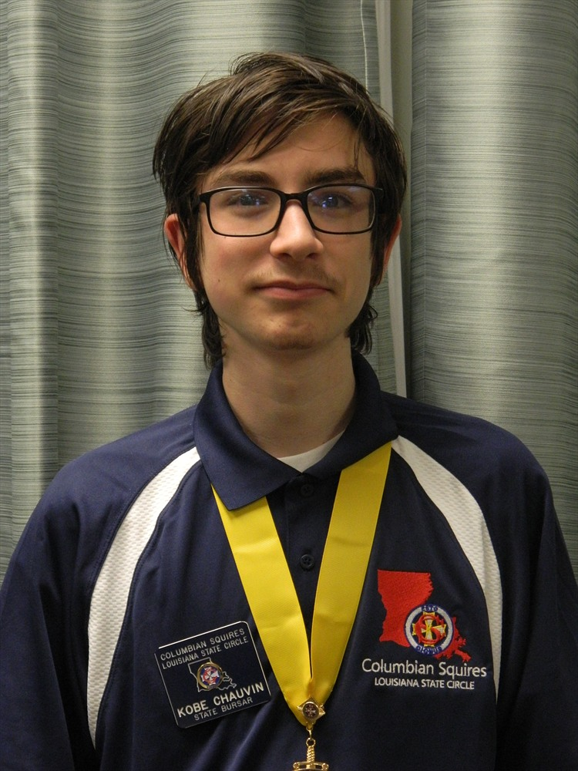
State Chief Squire
Kobe Chauvin
kobe.chauvin@lasquires.org

Slide 4
What is the Columbian squires?
A society for young catholic gentlemen ages 10-18 years old
The official Catholic youth arm of the Knights of Columbus
Future members of the Knights of Columbus**
The Columbian Squires organization is closely patterned after the Knights of Columbus
State Council = State Circle
Local Council= Local Circle

Slide 5
Squires Organizational Structure
SQUIRES
KNIGHTS
Chief Squire
Deputy Chief Squire
Notary
Bursar
Marshal
Sentry
Arm Captain
Pole Captain
Father Prior
Grand Knight
Deputy Grand Knight
Recorder
Treasurer
Warden
Inside Guard
Outside Guard
Guard
Chaplain
=

Slide 6
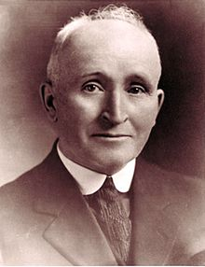
Founding of the Columbian Squires
Brother Barnabas McDonald, (real name, Edward Patrick McDonald)
August 4, 1925- Duluth, Minnesota, USA
Barnabas Circle No. 1, sponsored by Duluth Council No. 447

Slide 7
Founding of the Columbian Squires
“The supreme purpose of the Columbian Squires is Character Building” – Brother Barnabas McDonald, Squires Founder
“The most important factor in the success of our Columbian Squires program is the leadership which our mature knights furnish to adolescent squire” – Brother Barnabas McDonald, Squires Founder

Slide 8
STATE Columbian squires structure:
State Circle
Squire Roses Director
Local Roses Circles
Local Squires Circles
Squires Chairman

Slide 9
Our Goals for the year:
To facilitate Squires growth within our faith
To promote leadership and character building skills
Increase Membership
Create Quality New Circles
Enhance and Increase participation at State Events
To increase State Scholarship Fund
To create new programming that promotes physical activity

Slide 10
How can you help?
To support our fundraisers
Your council or assembly can create a Program with your Pastor for a Squires Circle
For you to become a counselor
For you to support our State Events
Spread the word about the Squires Program

Slide 11
Squires State Events 2016-2017
Fall
Spring
7/9 & 10 State Orientation and Installation New Orleans, La
8/6 Columbian Squires Leadership Seminar Houma, La
11/19 State Meeting Lafayette, La
1/7 State Retreat New Orleans, La
3/11 State Bowling Tournament, Houma, La
3/25 State Meeting, Lafayette, La
4/22 State Family Fun Day Slidell, La
6/2-4 State Squires Convention Slidell, La
For more information on our state events, visit our website http://www.lasquires.org/

Slide 12
Columbian Squires Leadership Seminar
CSLS 2016
Where: St. Anthony of Padua Catholic Church
When: Saturday, August 6, 2016
11am – 2pm
Registration: – July 7th – August 2nd
3897 Bayou Black Dr.
Houma, La 70360
Register via the State Circle website, http://www.lasquires.org/

Slide 13
How to contact US……..
State Website: LASQUIRES.ORG
State Circle Email: contact@lasquires.org
State Squires Chairman: Kerry T. Williams, Jr (kerry.williams@lasquires.org)
State Chief Squire: Kobe Chauvin (kobe.chauvin@lasquires.org)

Slide 14
www.lasquires.org

